Slide 1

BCS2313: Artificial Intelligence Techniques
Module 2.3:
HEURISTICS AND INFORMED SEARCH

Slide 2

Learning Objectives
Problem Types
Problem Formulation
Basic Search Algorithms
Informed Search Strategies

Slide 3
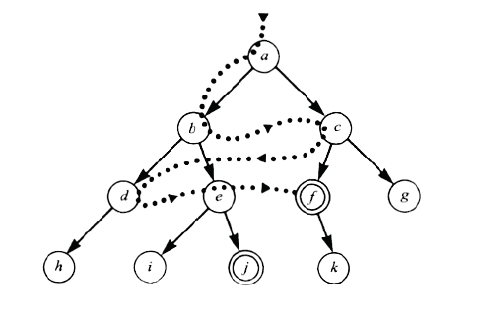
Using problem specific knowledge to aid searching
Without incorporating knowledge into searching, one can have no bias (i.e. a preference) on the search space.
Without a bias, one is forced to look everywhere to find the answer. Hence, the complexity of uninformed search is intractable.
Search everywhere!!

Slide 4
Using problem specific knowledge to aid searching
With knowledge, one can search the state space as if he was given “hints” when exploring a maze.
Heuristic information in search = Hints
Leads to dramatic speed up in efficiency.
A
B
C
D
E
Search only in this subtree!!
F
G
H
I
J
K
L
M
N
O

Slide 5
More formally, why heuristic functions work?
In any search problem where there are at most b choices at each node and a depth of d at the goal node, a naive search algorithm would have to, in the worst case, search around O(b^{d}) nodes before finding a solution (Exponential Time Complexity).
Heuristics improve the efficiency of search algorithms by reducing the effective branching factor from b to (ideally) a low constant b* such that
1 =< b* << b

Slide 6
Heuristic Functions
A heuristic function is a function f(n) that gives an estimation on the “cost” of getting from node n to the goal state – so that the node with the least cost among all possible choices can be selected for expansion first.
Three approaches to defining f:
f measures the value of the current state (its “goodness”)
f measures the estimated cost of getting to the goal from the current state:
f(n) = h(n) where h(n) = an estimate of the cheapest cost to get from n to a goal
f measures the estimated cost of getting to the goal state from the current state and the cost of the existing path to it. Often, in this case, we decompose f:
f(n) = g(n) + h(n) where g(n) = the cost to get to n (from initial state)
Source: : Russell and Norvig, “Artificial Intelligence: A Modern Approach”. 3rd Edition

Slide 7
Traditional informed search strategies
Greedy Best first search
“Always chooses the successor node with the best f value” where f(n) = h(n)
We choose the one that is nearest to the final state among all possible choices
Use straight-line distance heuristic
A* search
Best first search using an “admissible” heuristic function f that takes into account the current cost g
Always returns the optimal solution path

Slide 8
Informed Search Strategies
Greedy Search
eval-fn: f(n) = h(n)

Slide 9
Greedy Search
Start
State | Heuristic: h(n)
A | 366
B | 374
C | 329
D | 244
E | 253
F | 178
G | 193
H | 98
I | 0
A
75
118
140
B
C
111
E
D
80
99
G
F
97
H
211
101
I
Goal
f(n) = h (n) = straight-line distance heuristic

Slide 10
Greedy Search
Start
State | Heuristic: h(n)
A | 366
B | 374
C | 329
D | 244
E | 253
F | 178
G | 193
H | 98
I | 0
A
75
118
140
B
C
111
E
D
80
99
G
F
97
H
211
101
I
Goal
f(n) = h (n) = straight-line distance heuristic

Slide 11
Greedy Search
Start
State | Heuristic: h(n)
A | 366
B | 374
C | 329
D | 244
E | 253
F | 178
G | 193
H | 98
I | 0
A
75
118
140
B
C
111
E
D
80
99
G
F
97
H
211
101
I
Goal
f(n) = h (n) = straight-line distance heuristic

Slide 12
Greedy Search
Start
State | Heuristic: h(n)
A | 366
B | 374
C | 329
D | 244
E | 253
F | 178
G | 193
H | 98
I | 0
A
75
118
140
B
C
111
E
D
80
99
G
F
97
H
211
101
I
Goal
f(n) = h (n) = straight-line distance heuristic

Slide 13
Greedy Search
Start
State | Heuristic: h(n)
A | 366
B | 374
C | 329
D | 244
E | 253
F | 178
G | 193
H | 98
I | 0
A
75
118
140
B
C
111
E
D
80
99
G
F
97
H
211
101
I
Goal
f(n) = h (n) = straight-line distance heuristic

Slide 14
Greedy Search
Start
State | Heuristic: h(n)
A | 366
B | 374
C | 329
D | 244
E | 253
F | 178
G | 193
H | 98
I | 0
A
75
118
140
B
C
111
E
D
80
99
G
F
97
H
211
101
I
Goal
f(n) = h (n) = straight-line distance heuristic

Slide 15
Greedy Search
Start
State | Heuristic: h(n)
A | 366
B | 374
C | 329
D | 244
E | 253
F | 178
G | 193
H | 98
I | 0
A
75
118
140
B
C
111
E
D
80
99
G
F
97
H
211
101
I
Goal
f(n) = h (n) = straight-line distance heuristic

Slide 16
Greedy Search
Start
State | Heuristic: h(n)
A | 366
B | 374
C | 329
D | 244
E | 253
F | 178
G | 193
H | 98
I | 0
A
75
118
140
B
C
111
E
D
80
99
G
F
97
H
211
101
I
Goal
f(n) = h (n) = straight-line distance heuristic

Slide 17
Greedy Search
Start
State | Heuristic: h(n)
A | 366
B | 374
C | 329
D | 244
E | 253
F | 178
G | 193
H | 98
I | 0
A
75
118
140
B
C
111
E
D
80
99
G
F
97
H
211
101
I
Goal
f(n) = h (n) = straight-line distance heuristic

Slide 18
Greedy Search
Start
State | Heuristic: h(n)
A | 366
B | 374
C | 329
D | 244
E | 253
F | 178
G | 193
H | 98
I | 0
A
75
118
140
B
C
111
E
D
80
99
G
F
97
H
211
101
I
Goal
f(n) = h (n) = straight-line distance heuristic

Slide 19
Greedy Search: Tree Search
Start
A

Slide 20
Greedy Search: Tree Search
Start
A
75
118
[329]
140
[374]
B
C
[253]
E

Slide 21
Greedy Search: Tree Search
Start
A
75
118
[329]
140
[374]
B
C
[253]
E
80
99
[193]
[178]
G
F
[366]
A

Slide 22
Greedy Search: Tree Search
Start
A
75
118
[329]
140
[374]
B
C
[253]
E
80
99
[193]
[178]
G
F
[366]
A
211
[253]
I
[0]
E
Goal

Slide 23
Greedy Search: Tree Search
Start
A
75
118
[329]
140
[374]
B
C
[253]
E
80
99
[193]
[178]
G
F
[366]
A
211
[253]
E
I
Path cost(A-E-F-I) =140 + 99 + 211 = 450
dist(A-E-F-I) = 253 + 178 + 0 = 431
Goal

Slide 24
Greedy Search: Optimal ?
State | Heuristic: h(n)
A | 366
B | 374
C | 329
D | 244
E | 253
F | 178
G | 193
H | 98
I | 0
Start
A
75
118
140
B
C
111
E
D
80
99
G
F
97
H
211
101
I
f(n) = h (n) = straight-line distance heuristic
path(A-E-G-H-I) =140+80+97+101=418
Dist (A-E-G-H-I)=253+193+98+0= 544
Goal

Slide 25
Greedy Search: Complete ?
Start
State | Heuristic: h(n)
A | 366
B | 374
** C | 250
D | 244
E | 253
F | 178
G | 193
H | 98
I | 0
A
75
118
140
B
C
111
E
D
80
99
G
F
97
H
211
101
I
Goal
f(n) = h (n) = straight-line distance heuristic

Slide 26
Greedy Search: Tree Search
Start
A

Slide 27
Greedy Search: Tree Search
Start
A
75
118
[250]
140
[374]
B
C
[253]
E

Slide 28
Greedy Search: Tree Search
Start
A
75
118
[250]
140
[374]
B
C
[253]
E
111
[244]
D

Slide 29
Greedy Search: Tree Search
Start
A
75
118
[250]
140
[374]
B
C
[253]
E
111
[244]
D
Infinite Branch !
[250]
C

Slide 30
Greedy Search: Tree Search
Start
A
75
118
[250]
140
[374]
B
C
[253]
E
111
[244]
D
Infinite Branch !
[250]
C
[244]
D

Slide 31
Greedy Search: Tree Search
Start
A
75
118
[250]
140
[374]
B
C
[253]
E
111
[244]
D
Infinite Branch !
[250]
C
[244]
D

Slide 32
Greedy Search: Time and Space Complexity ?
Start
A
75
Greedy search is not optimal.
Greedy search is incomplete without systematic checking of repeated states.
In the worst case, the Time and Space Complexity of Greedy Search are both O(b^{m})
Where b is the branching factor and m the maximum path length
118
140
B
C
111
E
D
80
99
G
F
97
H
211
101
I
Goal

Slide 33
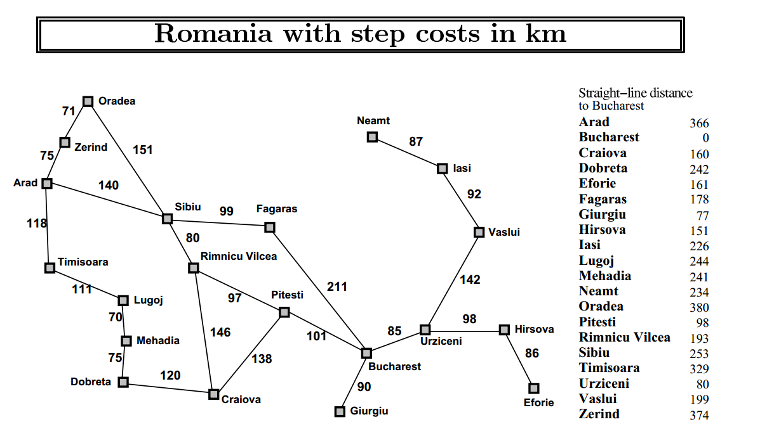
Question!
Initial State= Arad
Goal State= Bucharest

Slide 34
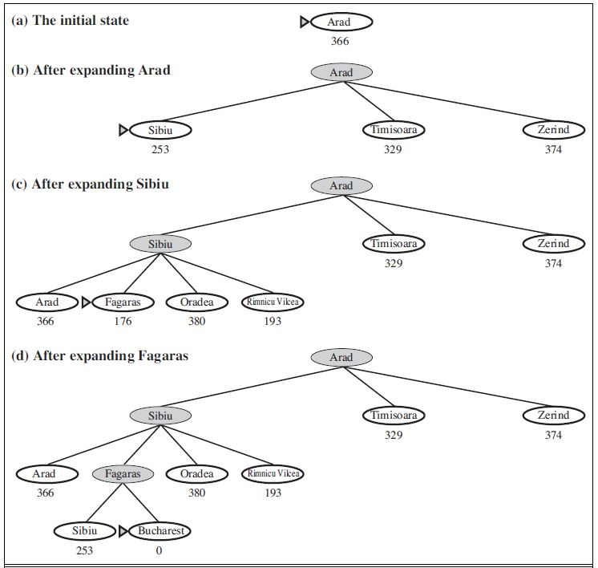
Figure 3.23 Stages in a greedy best-first tree search for Bucharest with the straight-line
distance heuristic hSLD. Nodes are labeled with their h-values.
Source: : Russell and Norvig, “Artificial Intelligence: A Modern Approach”. 3rd Edition

Slide 35
Informed Search Strategies
A* Search
eval-fn: f(n)=g(n)+h(n)

Slide 36
A* (A Star)
Greedy Search minimizes a heuristic h(n) which is an estimated cost from a node n to the goal state. Greedy Search is efficient, but it is not optimal nor complete.
Uniform Cost Search minimizes the cost g(n) from the initial state to n. UCS is optimal and complete but not efficient.
New Strategy: Combine Greedy Search and UCS to get an efficient algorithm which is complete and optimal.

Slide 37
A* (A Star)
A* uses a heuristic function which combines g(n) and h(n): f(n) = g(n) + h(n)
g(n) is the exact cost to reach node n from the initial state.
h(n) is an estimation of the remaining cost to reach the goal.
The algorithm is identical to UNIFORM-COST-SEARCH except that A∗ uses g + h instead of g

Slide 38
A* (A Star)
g(n)
f(n) = g(n)+h(n)
n
h(n)

Slide 39
A* Search
State | Heuristic: h(n)
A | 366
B | 374
C | 329
D | 244
E | 253
F | 178
G | 193
H | 98
I | 0
Start
A
75
118
140
B
C
111
E
D
80
99
G
F
97
H
211
f(n) = g(n) + h (n)
g(n): is the exact cost to reach node n from the initial state.
101
I
Goal

Slide 40
A* Search: Tree Search
A
Start

Slide 41
A* Search: Tree Search
A
Start
118
75
140
E
[393]
B
[449]
[447]
C

Slide 42
A* Search: Tree Search
A
Start
118
75
140
E
[393]
B
[449]
[447]
C
80
99
[413]
G
F
[417]

Slide 43
A* Search: Tree Search
A
Start
118
75
140
E
[393]
B
[449]
[447]
C
80
99
[413]
G
F
[417]
97
[415]
H

Slide 44
A* Search: Tree Search
A
Start
118
75
140
E
[393]
B
[449]
[447]
C
80
99
[413]
G
F
[417]
97
[415]
H
101
I
[418]
Goal

Slide 45
A* Search: Tree Search
A
Start
118
75
140
E
[393]
B
[449]
[447]
C
80
99
[413]
G
F
[417]
97
[415]
H
I
[450]
101
I
[418]
Goal

Slide 46
A* Search: Tree Search
A
Start
118
75
140
E
[393]
B
[449]
[447]
C
80
99
[413]
G
F
[417]
97
[415]
H
I
[450]
101
I
[418]
Goal

Slide 47
A* Search: Tree Search
A
Start
118
75
140
E
[393]
B
[449]
[447]
C
80
99
[413]
G
F
[417]
97
[415]
H
I
[450]
101
I
[418]
Goal

Slide 48
QUESTION!
Initial State= Arad
Goal State= Bucharest

Slide 49
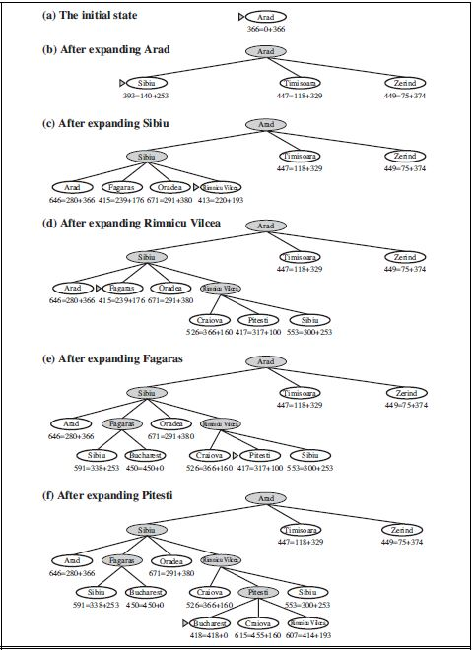
Figure 3.24 Stages in an A∗ search for Bucharest. Nodes are labeled with f = g +h. The h values are the straight-line distances to Bucharest
Source: : Russell and Norvig, “Artificial Intelligence: A Modern Approach”. 3rd Edition

Slide 50
A* with f() not Admissible
h() overestimates the cost to reach the goal state

Slide 51
A* Search: h not admissible !
Heuristic: h(n)
366
374
329
244
253
178
193
138
0
Start
A
75
118
140
B
C
111
E
D
80
99
G
F
97
H
211
101
I
f(n) = g(n) + h (n) – (H-I) Overestimated
g(n): is the exact cost to reach node n from the initial state.
Goal

Slide 52
A* Search: Tree Search
A
Start

Slide 53
A* Search: Tree Search
A
Start
118
75
140
E
[393]
B
[449]
[447]
C

Slide 54
A* Search: Tree Search
A
Start
118
75
140
E
[393]
B
[449]
[447]
C
80
99
[413]
G
F
[417]

Slide 55
A* Search: Tree Search
A
Start
118
75
140
E
[393]
B
[449]
[447]
C
80
99
[413]
G
F
[417]
97
[455]
H

Slide 56
A* Search: Tree Search
A
Start
118
75
140
E
[393]
B
[449]
[447]
C
80
99
[413]
G
F
[417]
97
[455]
Goal
H
I
[450]

Slide 57
A* Search: Tree Search
A
Start
118
75
140
E
[393]
B
[449]
[447]
C
80
99
[473]
[413]
G
F
[417]
D
97
[455]
Goal
H
I
[450]

Slide 58
A* Search: Tree Search
A
Start
118
75
140
E
[393]
B
[449]
[447]
C
80
99
[473]
[413]
G
F
[417]
D
97
[455]
Goal
H
I
[450]

Slide 59
A* Search: Tree Search
A
Start
118
75
140
E
[393]
B
[449]
[447]
C
80
99
[473]
[413]
G
F
[417]
D
97
[455]
Goal
H
I
[450]

Slide 60
A* Search: Tree Search
A
Start
118
75
140
E
[393]
B
[449]
[447]
C
80
99
[473]
[413]
G
F
[417]
D
97
[455]
Goal
H
I
[450]
A* not optimal !!!

Slide 61
A* Algorithm
A* with systematic checking for repeated states …

Slide 62
A* Algorithm
1. Search queue Q is empty.
2. Place the start state s in Q with f value h(s).
3. If Q is empty, return failure.
4. Take node n from Q with lowest f value.
(Keep Q sorted by f values and pick the first element).
5. If n is a goal node, stop and return solution.
6. Generate successors of node n.
7. For each successor n’ of n do:
a) Compute f(n’) = g(n) + cost(n,n’) + h(n’).
b) If n’ is new (never generated before), add n’ to Q.
c) If node n’ is already in Q with a higher f value, replace it with current f(n’) and place it in sorted order in Q.
End for
8. Go back to step 3.

Slide 63
A* Search: Analysis
A* is complete except if there is an infinity of nodes with f < f(G).
A* is optimal if heuristic h is admissible.
Time complexity depends on the quality of heuristic but is still exponential.
For space complexity, A* keeps all nodes in memory. A* has worst case O(b^{d}) space complexity, but an iterative deepening version is possible (IDA*).
Start
A
75
118
140
B
C
111
E
D
80
99
G
F
97
H
211
101
I
Goal

Slide 64
Informed Search Strategies
Iterative Deepening A*

Slide 65
Iterative Deepening A*:IDA*
Use f(N) = g(N) + h(N) with admissible and consistent h
Each iteration is depth-first with cutoff on the value of f of expanded nodes

Slide 66
Consistent Heuristic
The admissible heuristic h is consistent (or satisfies the monotone restriction) if for every node N and every successor N’ of N: h(N) ≤ c(N,N’) + h(N’) (triangular inequality)
A consistent heuristic is admissible.
N
c(N,N’)
N’
h(N)
h(N’)

Slide 67
IDA* Algorithm
In the first iteration, we determine a “f-cost limit” – cut-off value f(n₀) = g(n₀) + h(n₀) = h(n₀), where n₀ is the start node.
We expand nodes using the depth-first algorithm and backtrack whenever f(n) for an expanded node n exceeds the cut-off value.
If this search does not succeed, determine the lowest f-value among the nodes that were visited but not expanded.
Use this f-value as the new limit value – cut-off value and do another depth-first search.
Repeat this procedure until a goal node is found.

Slide 68
8-Puzzle
f(N) = g(N) + h(N)
with h(N) = number of misplaced tiles
4
Cutoff=4
Goal
6

Slide 69
8-Puzzle
f(N) = g(N) + h(N)
with h(N) = number of misplaced tiles
4
Cutoff=4
4
Goal
6
6

Slide 70
8-Puzzle
f(N) = g(N) + h(N)
with h(N) = number of misplaced tiles
4
Cutoff=4
4
5
Goal
6
6

Slide 71
8-Puzzle
f(N) = g(N) + h(N)
with h(N) = number of misplaced tiles
5
4
Cutoff=4
4
5
Goal
6
6

Slide 72
8-Puzzle
f(N) = g(N) + h(N)
with h(N) = number of misplaced tiles
6
5
4
Cutoff=4
4
5
Goal
6
6

Slide 73
8-Puzzle
f(N) = g(N) + h(N)
with h(N) = number of misplaced tiles
4
Cutoff=5
Goal
6

Slide 74
8-Puzzle
f(N) = g(N) + h(N)
with h(N) = number of misplaced tiles
4
Cutoff=5
4
Goal
6
6

Slide 75
8-Puzzle
f(N) = g(N) + h(N)
with h(N) = number of misplaced tiles
4
Cutoff=5
4
5
Goal
6
6

Slide 76
8-Puzzle
f(N) = g(N) + h(N)
with h(N) = number of misplaced tiles
4
Cutoff=5
4
5
Goal
7
6
6

Slide 77
8-Puzzle
f(N) = g(N) + h(N)
with h(N) = number of misplaced tiles
4
5
Cutoff=5
4
5
Goal
7
6
6

Slide 78
8-Puzzle
f(N) = g(N) + h(N)
with h(N) = number of misplaced tiles
4
5
5
Cutoff=5
4
5
Goal
7
6
6

Slide 79
8-Puzzle
f(N) = g(N) + h(N)
with h(N) = number of misplaced tiles
4
5
5
Cutoff=5
4
5
Goal
7
6
6

Slide 80
When to Use Search Techniques
The search space is small, and
There are no other available techniques, or
It is not worth the effort to develop a more efficient technique
The search space is large, and
There is no other available techniques, and
There exist “good” heuristics

Slide 81
Conclusions
Frustration with uninformed search led to the idea of using domain specific knowledge in a search so that one can intelligently explore only the relevant part of the search space that has a good chance of containing the goal state. These new techniques are called informed (heuristic) search strategies.
Even though heuristics improve the performance of informed search algorithms, they are still time consuming especially for large size instances.

Slide 82

82

